Slide 1

APEX INSTITUTE OF TECHNOLOGY
DEPARTMENT OF COMPUTER SCIENCE & ENGINEERING
Computer Organization & Architecture (21CSH-281)
Faculty: Siddharth Kumar (E12853)
Lecture - 15
Computer Arithmetic: Floating Point Arithmetic & IEEE 754 Format
DISCOVER . LEARN . EMPOWER

Slide 2
Computer Organization & Architecture: Course Objectives
COURSE OBJECTIVES
The course aims to:
The purpose of the course is to introduce principles of computer organization and the basic architectural concepts.
It begins with basic organization, design, and programming of a simple digital computer and introduces simple register transfer language to specify various computer operations.
Topics include computer arithmetic, instruction set design, microprogrammed control unit, pipelining and vector processing, memory organization and I/O systems, and multiprocessors.
To familiarize Students with the detailed Architectures of a Central Processing Unit.
Learn the different types of serial communication techniques.

Slide 3
COURSE OUTCOMES
On completion of this course, the students shall be able to:-
CO1 | Identify and interpret the basics of instruction sets and their impact on the design, organization, and functionality of various functional units of a computer comparable to the CPU, memory organization, I/O organization, and parallel processors.
CO2 | Analysis of the design of arithmetic & logic unit and understanding of the fixed point and floating-point arithmetic operations.
CO3 | Relate cost performance and design trade-offs in designing and constructing a computer processor which includes memory.
CO4 | Understanding the different ways of communicating with I/O devices and standard I/O interfaces.
CO5 | Implementation of control unit techniques and the concept of Pipelining.

Slide 4
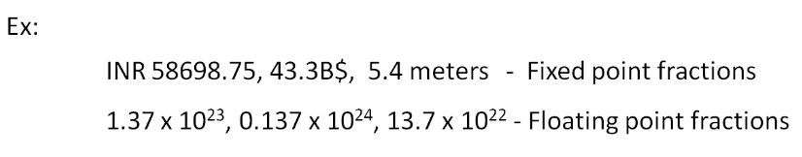

Floating-Point Arithmetic
A floating-point (FP) number is a kind of fraction where the radix point is allowed to move. If the radix point is fixed, then those fractional numbers are called fixed-point numbers. The best example of fixed-point numbers are those represented in commerce, finance while that of floating-point is the scientific constants and values.
The disadvantage of fixed-point is that not all numbers are easily representable. For example, continuous fractions are difficult to be represented in fixed-point form. Also, very small and very large fractions are almost impossible to be fitted with efficiency.
A floating-point number representation is standardized by IEEE with three components namely the sign bit, Mantissa and the exponent. The number is derived as:

Slide 5
Why do we need floating point?
Several reasons:
Many numeric applications need numbers over a huge range
e.g., nanoseconds to centuries
Most scientific applications require real numbers (e.g. π)
But so far we only have integers and what do we do?
We could implement the fractions explicitly
e.g.: ½, 1023/102934
We could use bigger integers
e.g.: 64-bit integers
Floating-point representation is often better
has some drawbacks too!

Slide 6
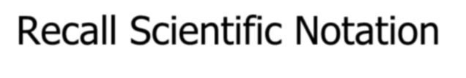





























 Recall scientific notation from high school
Numbers represented in parts:
Significant Digits Exponent
42 = 4.200 x 10¹
1024 = 1.024 x 10³
-0.0625 = -6.250 x 10⁻²
 Arithmetic is done in pieces
 | 1024 | 1.024 x 10³
 | - 42 | -0.042 x 10³
= | 982 | 0.982 x 10³
= |  | 9.820 x 10²
Before adding, we must match the exponents, effectively “denormalizing” the smaller
magnitude number
We then “normalize” the final result so there is one digit to the left of the decimal point and adjust the exponent
accordingly.

Slide 7
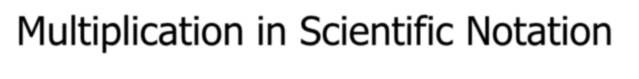

















 Is straightforward:
Multiply together the significant parts
Add the exponents
Normalize if required
 Examples:
In multiplication, how far is the most you will ever normalize?
1024
x 0.0625
1.024 x 10³
6.250 x 10⁻²
6.400 x 10¹
In addition?
= 64
42
x 0.0625
= 2.625
=
4.200 x 10¹
6.250 x 10⁻²
26.250 x 10⁻¹
2.625 x 10⁰ (Normalized)
Source: https://rmd.ac.in/dept/ece/Supporting_Online_%20Materials/5/CAO/unit1.pdf

Slide 8
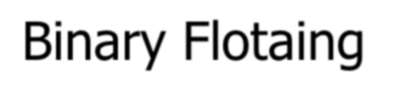

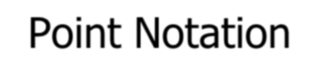
























 IEEE single precision floating-point format
Example: (0x42280000 in hexadecimal)
0 |  | 1 | 0 | 0 | 0 | 0 | 1 | 0 | 0 | 0 | 1 | 0 | 1 | 0 | 0 | 0 | 0 | 0 | 0 | 0 | 0 | 0 | 0 | 0 | 0 | 0 | 0 | 0 | 0 | 0 | 0 | 0
“S”
Sign Bit
“E”
Exponent + 127
“F”
Significand (Mantissa) - 1
 Three fields:
Sign bit (S)
Exponent (E): Unsigned “Bias 127” 8-bit integer
E = Exponent + 127
Exponent = 10000100 (132) – 127 = 5
Significand (F): Unsigned fixed binary point with “hidden-one”
Significand = “1”+ 0.01010000000000000000000 = 1.3125
Final value: N = -1^{S} (1+F) x 2^{E-127} = -1⁰(1.3125) x 2⁵ = 42
Source: https://rmd.ac.in/dept/ece/Supporting_Online_%20Materials/5/CAO/unit1.pdf

Slide 9
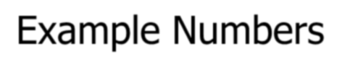


















 One
Sign = +, Exponent = 0, Significand = 1.0
1 = -1⁰ (1.0) x 2⁰
S = 0, E = 0 + 127, F = 1.0 – ‘1’
0 01111111 00000000000000000000000 = 0x3f800000
 One-half
Sign = +, Exponent = -1, Significand = 1.0
½ = -1⁰ (1.0) x 2⁻¹
S = 0, E = -1 + 127, F = 1.0 – ‘1’
0 01111110 00000000000000000000000 = 0x3f000000
 Minus Two
Sign = -, Exponent = 1, Significand = 1.0
-2 = -1¹ (1.0) x 2¹
1 10000000 00000000000000000000000 = 0xc0000000
Source: https://rmd.ac.in/dept/ece/Supporting_Online_%20Materials/5/CAO/unit1.pdf

Slide 10
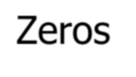


 How do you represent 0?
Sign = ?, Exponent = ?, Significand = ?
Here’s where the hidden “1” comes back to bite you
Hint: Zero is small. What’s the smallest number you can generate?
– Exponent = -127, Signficand = 1.0
– -1⁰ (1.0) x 2⁻¹²⁷ = 5.87747 x 10⁻³⁹
 IEEE Convention
When E = 0 (Exponent = -127), we’ll interpret numbers
differently…
0 00000000 00000000000000000000000 = 0 not 1.0 x 2⁻¹²⁷
1 00000000 00000000000000000000000 = -0 not -1.0 x 2⁻¹²⁷
Yes, there are “2” zeros. Setting E=0 is also used to represent a few other small numbers besides 0. In all of these numbers there is no “hidden” one assumed in F, and they are called the “unnormalized numbers”. WARNING: If you rely these values you are skating on thin ice!
Source: https://rmd.ac.in/dept/ece/Supporting_Online_%20Materials/5/CAO/unit1.pdf

Slide 11
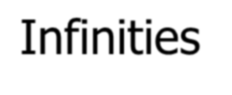
 IEEE floating point also reserves the largest possible exponent to represent “unrepresentable” large numbers
Positive Infinity: S = 0, E = 255, F = 0
0 11111111 00000000000000000000000 = +∞
0x7f800000
Negative Infinity: S = 1, E = 255, F = 0
1 11111111 00000000000000000000000 = -∞
0xff800000
Other numbers with E = 255 (F ≠ 0) are used to represent
exceptions or Not-A-Number (NAN)
√-1, -∞ x 42, 0/0, ∞/∞, log(-5)
It does, however, attempt to handle a few special cases:
1/0 = + ∞, -1/0 = - ∞, log(0) = - ∞
Source: https://rmd.ac.in/dept/ece/Supporting_Online_%20Materials/5/CAO/unit1.pdf

Slide 12
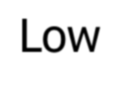
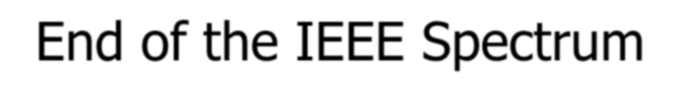
Low-End of the IEEE Spectrum
denorm _{2-bias}
0
₂1-bias
₂2-bias
gap
normal numbers with hidden bit
 “Denormalized Gap”
The gap between 0 and the next representable normalized number is much larger than the gaps between nearby representable numbers
IEEE standard uses denormalized numbers to fill in the gap,
making the distances between numbers near 0 more alike
Denormalized numbers have a hidden “0” and…
… a fixed exponent of -126
X = -1^{S} 2⁻¹²⁶ (0.F)
– Zero is represented using 0 for the exponent and 0 for the mantissa.
Either, +0 or -0 can be represented, based on the sign bit.

Slide 13
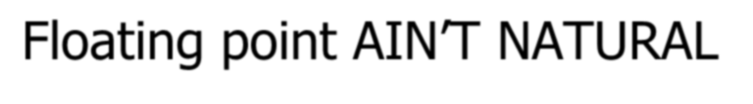
 It is CRUCIAL for computer scientists to know that Floating Point arithmetic is NOT the arithmetic you learned since childhood
 1.0 is NOT EQUAL to 10*0.1 (Why?)
1.0 * 10.0 == 10.0
0.1 * 10.0 != 1.0
0.1 decimal == 1/16 + 1/32 + 1/256 + 1/512 + 1/4096 + … ==
0.0 0011 0011 0011 0011 0011 …
In decimal 1/3 is a repeating fraction 0.333333…
If you quit at some fixed number of digits, then 3 * 1/3 != 1
 Floating Point arithmetic IS NOT associative
x + (y + z) is not necessarily equal to (x + y) + z
 Addition may not even result in a change
(x + 1) MAY == x
Source: https://rmd.ac.in/dept/ece/Supporting_Online_%20Materials/5/CAO/unit1.pdf

Slide 14
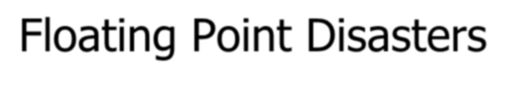
 Scud Missiles get through, 28 die
In 1991, during the 1st Gulf War, a Patriot missile defense system let a Scud get through, hit a barracks, and kill 28 people. The problem was due to a floating-point error when taking the difference of a converted & scaled integer. (Source: Robert Skeel, "Round-off error cripples Patriot Missile", SIAM News, July 1992.)
 $7B Rocket crashes (Ariane 5)
When the first ESA Ariane 5 was launched on June 4, 1996, it lasted only 39 seconds, then the rocket veered off course and self-destructed. An inertial system, produced a floating-point exception while trying to convert a 64-bit floating-point number to an integer. Ironically, the same code was used in the Ariane 4, but the larger values were never generated (http://www.around.com/ariane.html).
 Intel Ships and Denies BugsIn 1994, Intel shipped its first Pentium processors with a floating-point divide bug. The bug was due to bad look-up tables used to speed up quotient calculations. After months of denials, Intel adopted a no-questions replacement policy, costing $300M. (http://www.intel.com/support/processors/pentium/fdiv/)
Source: https://rmd.ac.in/dept/ece/Supporting_Online_%20Materials/5/CAO/unit1.pdf

Slide 15



Step 1:
Multiply significands
Add exponents
S
E
F
S | E | F
×
24 by 24
E_{R} = E₁ + E₂ -127
(do not need twice the bias)
Small ADDER
Subtract 127
Control
Step 2: Normalize result (Result of
[1,2) *[1.2) = [1,4)
at most we shift right one bit, and fix exponent
round
Add 1
Mux
(Shift Right by 1)
S | E | F
Source: https://rmd.ac.in/dept/ece/Supporting_Online_%20Materials/5/CAO/unit1.pdf

Slide 16

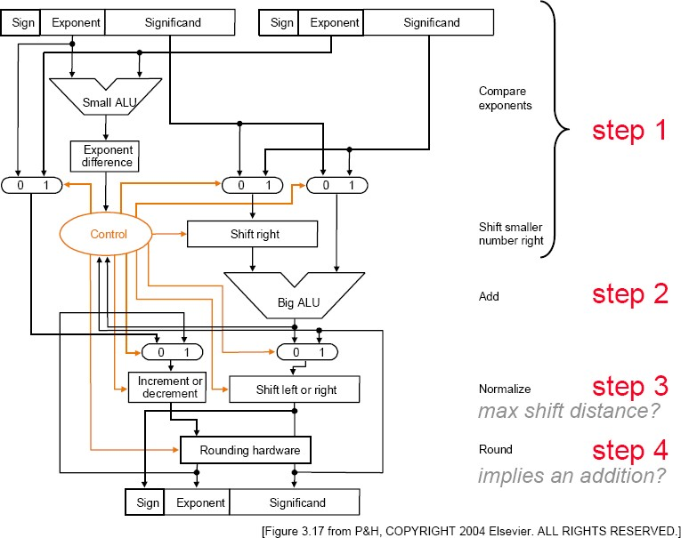
Floating-Point Addition
Source: https://rmd.ac.in/dept/ece/Supporting_Online_%20Materials/5/CAO/unit1.pdf

Slide 17
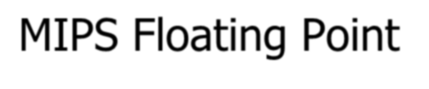
 Floating point “Co-processor”
32 Floating point registers
separate from 32 general purpose registers
32 bits wide each
use an even-odd pair for double precision
 Instructions:
add.d fd, fs, ft # fd = fs + ft in double precision
add.s fd, fs, ft # fd = fs + ft in single precision
sub.d, sub.s, mul.d, mul.s, div.d, div.s, abs.d, abs.s
l.d fd, address # load a double from address
l.s, s.d, s.s
Conversion instructions
Compare instructions
Branch (bc1t, bc1f)
Source: https://rmd.ac.in/dept/ece/Supporting_Online_%20Materials/5/CAO/unit1.pdf

Slide 18
 From bits to numbers:
Computer arithmetic is constrained by limited precision
Bit patterns have no inherent meaning but standards do exist
two’s complement
IEEE 754 floating point
Instructions determine “meaning” of the bit patterns
 Performance and accuracy
… are important so there are many complexities in real
machines (i.e., algorithms and implementation).
Accurate numerical computing requires methods quite
different from those of the math you learned in grade school.
Source: https://rmd.ac.in/dept/ece/Supporting_Online_%20Materials/5/CAO/unit1.pdf

Slide 19
Summary
Discussed about Floating Point arithmetic
Discussed about MIPS floating point
Assessment Questions
Q1. The twos complement integer division algorithm is known as the restoring method because the value in the A register must be restored following unsuccessful subtraction. A slightly more complex approach, known as no restoring, avoids the unnecessary subtraction and addition. Propose an algorithm for this latter approach.

Slide 20
THANK YOU

